Slide 1
UNIX
By Suraj Yadav

Slide 2
HIstory
1969
Kem thomson
Dennis ritche
OS basics

Slide 3





Commercial Success
AIX
SunOS, Solaris
Ultrix, Digital Unix
HP-UX
Irix
UnixWare -> Novell -> SCO -> Caldera ->SCO
Xenix: -> SCO
Standardization (Posix, X/Open)
Notes:
Early eighties: lots of commercial spinoffs.
XENIX: Port for microcomputers by microsoft, but inadequate. Sold to SCO after switch to QDOS (quick and dirty)
SUN: Bill Joy’s startup launched in 1982
SCO: One of the first (1978)
UnixWare: AT&T’s.

Slide 4


Send in the Clones
Linux
Written in 1991 by Linus Torvalds
Most popular UNIX variant
Free with GNU license
BSD Lite
FreeBSD (1993, focus on PCs)
NetBSD (1993, focus on portability)
OpenBSD (1996, focus on security)
Free with BSD license
Development less centralized
Notes:
GNU and BSD licenses have major differences.

Slide 5
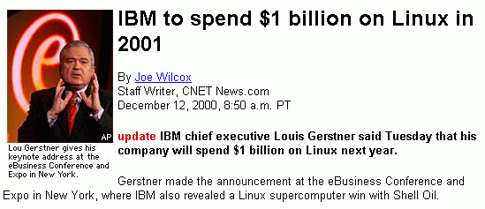
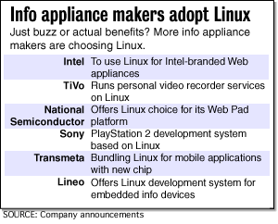
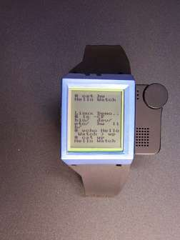
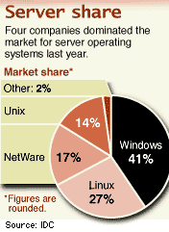
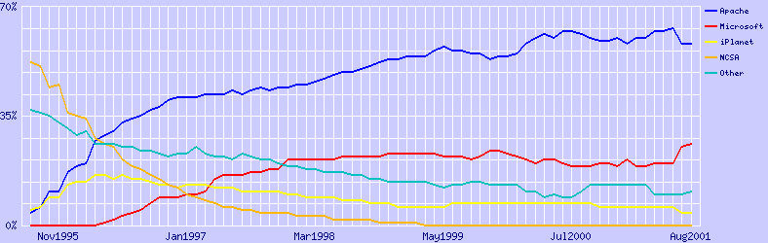
Today: Unix is Big
Notes:
Over 70% of all web servers run UNIX variants.
Other uses: FAA, Mars Pathfinder,

Slide 6

The Open Source Movement
Has fueled much growth in UNIX
Keeps up with pace of change
More users, developers
More platforms, better performance, better code
Many vendors switching to Linux

Slide 7

The UNIX Philosophy
Small is beautiful
Easy to understand
Easy to maintain
More efficient
Better for reuse
Make each program do one thing well
More complex functionality by combining programs
Make every program a filter
Notes:
Core Idea: #1
#2 is an example of #1

Slide 8
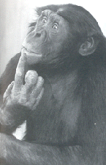
The UNIX Philosophy
..continued
Portability over efficiency
Most efficient implementation is rarely portable
Portability better for rapidly changing hardware
Use flat ASCII files
Common, simple file format (yesterday’s XML)
Example of portability over efficiency
Reusable code
Good programmers write good code; great programmers borrow good code
Notes:
Example: Failure of ATARI 2600 move to ATARI 800 (hard (8K) so highly non portable)

Slide 9
The UNIX Philosophy
..continued
Scripting increases leverage and portability
print $(who | awk '{print $1}' | sort | uniq) | sed 's/ /,/g'
List the logins of a system’s users on a single line.
who | 755
awk | 3,412
sort | 2,614
uniq | 302
sed | 2,093
Build prototypes quickly (high level interpreted languages)
9,176 lines

Slide 10
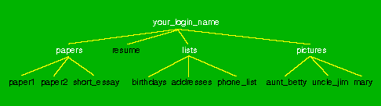
The UNIX Philosophy
..continued
Avoid captive interfaces
The user of a program isn’t always human
Look nice, but code is big and ugly
Problems with scale
Silence is golden
Only report if something is wrong
Think hierarchically

Slide 11
UNIX Highlights / Contributions
Portability (variety of hardware; C implementation)
Hierarchical file system; the file abstraction
Multitasking and multiuser capability for minicomputer
Inter-process communication
Pipes: output of one programmed fed into input of another
Software tools
Development tools
Scripting languages
TCP/IP

Slide 12
UNIX Structural Layout
shell scripts
User Space
utilities
C programs
system calls
compilers
signal handler
Kernel
scheduler
device drivers
swapper
terminal
Devices
printer
disk
RAM

Slide 13
Kernel Basics
The kernel is …
a program loaded into memory during the boot process, and always stays in physical memory.
responsible for managing CPU and memory for processes, managing file systems, and interacting with devices.

Slide 14
Kernel Subsystems
Process management
Schedule processes to run on CPU
Inter-process communication (IPC)
Memory management
Virtual memory
Paging and swapping
I/O system
File system
Device drivers
Buffer cache

Slide 15
System Calls
Interface to the kernel
Over 1,000 system calls available on Linux
3 main categories
File/device manipulation
e.g. mkdir(), unlink()
Process control
e.g. fork(), execve(), nice()
Information manipulation
e.g. getuid(), time()

Slide 16
Logging In
Need an account and password first
Enter at login: prompt
Password not echoed
After successful login, you will see a shell prompt
Entering commands
At the shell prompt, type in commands
Typical format: command options arguments
Examples: who, date, ls, cat myfile, ls –l
Case sensitive
exit to log out

Slide 17
About login Begins a session on the system.
The login program is used to establish a new session with the system. It is normally invoked automatically by responding to the "login:" prompt on the user's terminal. login may be special to the shell and may not be invoked as a sub-process. When called from a shell, login should be executed as exec login which will cause the user to exit from the current shell (and thus will prevent the new logged in user to return to the session of the caller). Attempting to execute login from any shell but the login shell will produce an error message.

Slide 18
@What happenes when you login
The user is then prompted for a password, where appropriate. Echoing is disabled to prevent revealing the password. Only a small number of password failures are permitted before login exits and the communications link is severed.
If password aging has been enabled for your account, you may be prompted for a new password before proceeding. You will be forced to provide your old password and the new password before continuing; refer to our passwd for more information.
Your user and group ID will be set according to their values in the /etc/passwd file. The value for $HOME, $SHELL, $PATH, $LOGNAME, and $MAIL are set according to the appropriate fields in the password entry. ulimit, umask and nice values may also be set according to entries in the GECOS field.
On some installations, the environment variable $TERM will be initialized to the terminal type on your tty line, as specified in /etc/ttytype.

Slide 19
@Related commands
csh — The C shell command interpreter. exit — Exit the command shell. init — The parent of all processes on the system. ksh — The Korn shell command interpreter. mail — Read, compose, and manage mail. mailx — Process mail messages. newgrp — Log into a new group. passwd — Change a user's password. rlogin — Begin a session on a remote system. rsh — Execute a command on a remote shell. sh — The Bourne shell command interpreter. telnet — Connect to a remote system using the telnet protocol. umask — Get or set the file mode creation mask.

Slide 20
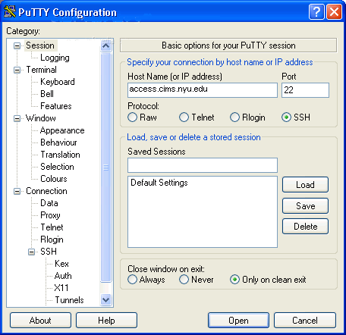
Remote Login
Use Secure Shell (SSH)
Windows
e.g. PuTTY
UNIX-like OS
Ssh suraj.kumar.yadav@cgi.com

Slide 21
UNIX on Windows
Two recommended UNIX emulation environments:
UWIN (AT&T)
http://www.research.att.com/sw/tools/uwin
Cygwin (GPL)
http://www.cygwin.com

Slide 22

Assignment 0
Get an account
Log in and run a program
Join the mailing list
Submit a text file

Slide 23
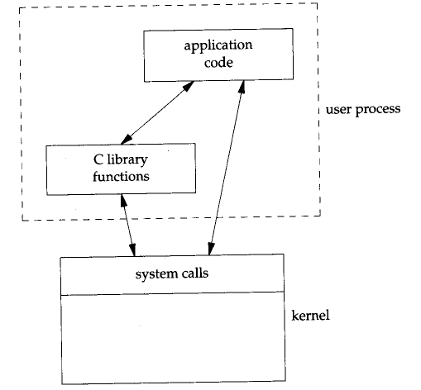
System Calls
The kernel implements a set of special routines
A user program invokes a routine in the kernel by issuing a hardware TRAP
The trap switches the CPU into a privileged mode and the kernel executes the system call
The CPU goes back to user mode
A C language API exists for all system calls

Slide 24
@text file-1 (unix system calls)
Go through the text file for more in depth hands on exercise

Slide 25
SCO: Line by Line Copying
System V Code Unix Kernel Code
/*
* Allocate 'size' units from the given map.
* Return the base of the allocated space.
* In a map, the addresses are increasing and the
* list is terminated by a 0 size.
* The swap map unit is 512 bytes.
* Algorithm is first-fit.
*
∗ Ασ παρτ οφ τηε κερνελ εϖολυτιον τοωαρδ μοδυλαρ ναμινγ, τηε
∗ φυνχτιονσ μαλλοχ ανδ μφρεε αρε βεινγ ρεναμεδ το ρμαλλοχ ανδ ρμφρεε.
∗ Χομπατιβιλιτψ ωιλλ βε μαινταινεδ βψ τηε φολλοωινγ ασσεμβλερ χοδε:
∗ (αλσο σεε μφρεε/ρμφρεε βελοω)
∗/
…
/*
* Allocate 'size' units from the given map.
* Return the base of the allocated space.
* In a map, the addresses are increasing and the
* list is terminated by a 0 size.
* Algorithm is first-fit.
*/
ulong_t
atealloc(
struct map *mp,
size_t size)
{
register unsigned int a;
register struct map *bp;
register unsigned long s;
…

Slide 26
BETTER BE GOOD WID C TO UNDERSTAND UNIX INNER CODE FUNCTIONALITY ( As kernal calls are written in code (my guys)

